Slide 1
Taking [some of] the Wicked out of the Cyber Problem
Society for Risk Analysis Annual Meeting
Roundtable Discussion
13 December 2023
Moderator: Debra Decker, Stimson Center
Panelists:
Rosa Celerio, George Washington University Law School, International Law Program
Christopher Ford, Hoover Institution (recorded)
Fabio Massacci, University of Trento, Vrije Universiteit of Amsterdam
Unal Tatar, State University of New York-Albany

Slide 2
Discussion Overview
Goal: Consider Better Ways to Manage Cyber Risks
Why Cyber is Wicked
Current Attempts to Manage Cyber Risks
Manage C - Protection and Resilience
Manage V- Vulnerability Management
Manage T- Accountability
Stimson Center’s Accountability Project
Brainstorming Better Futures: How Get Agreement and Accountability?!

Slide 3
Why is Cyber Wicked?
Different framings, worldviews and values, as well as high uncertainty
General characterizations of wicked problems
No clear definition or solution
Many approaches possible but testing outcomes hard
Unique
Other problems
Summary of discussions in recent articles in Journal of Risk Analysis, and of Horst Rittel and Melvin Webber’s work, summarized from: https://www.stonybrook.edu/commcms/wicked-problem/about/What-is-a-wicked-problem#:~:text=As%20described%20by%20Rittel%20and,false%2C%20only%20good%20or%20bad.
https://www.iso.org/obp/ui/#iso:std:iso:31000:ed-2:v1:en

Slide 4
Suggested Approaches
From Journal of Risk Analysis articles
Apply multi-criteria decision analysis
Engage stakeholders – recognize values and beliefs
Develop common agreement on facts
Have iterative dialogues
But among nations especially, the context is key – ISO 3100 Risk Management Frame
See Risk Analysis articles, for example, by Rober Lampert and Sara Taylor, Paul Stern, JoAnne Lennerooth-Bayer. Risk Management Framework 3100, https://www.iso.org/obp/ui/#iso:std:iso:31000:ed-2:v1:en

Slide 5

Perspectives on Wicked Risks

Slide 6
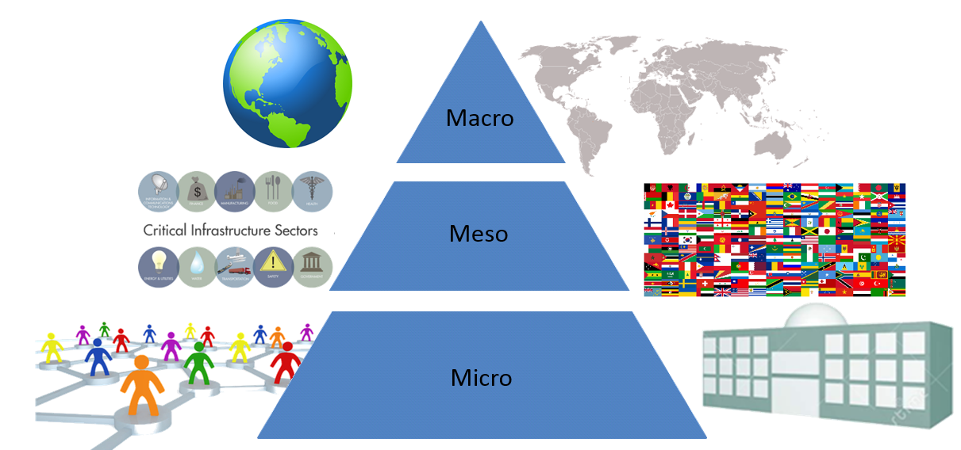
Dynamics of Cyber Environment
Governmental
Political
Technological
Environmental
Economic
Behavioral
Social
Legal
TECHNICAL LAYER

Slide 7
Current Attempts to Tame Cyber
Reduce Consequences - Resilience!
CERTs, GFCE…
NIST Cyber Framework, ISO 27001, DOD CMMC
Identify, Protect, Detect, Respond, Recover
Defense Forward

Slide 8
Current Attempts to Tame Cyber
GFCE, NIST Cyber Framework...- End-user responsibility
Vulnerability management
Shifting liability to hardware/software/MSPs
Understanding Supply chain security
Responsible Disclosure and Information Sharing

Slide 9





First a Look at Liability Laws
What happens if
If a [builder] did not properly construct the house for a fellow [ . . . ] and a wall fell
If the house fell and it ruins goods
If the builder wants to change the walls or close a window after the sale
Work partly supported by the NWO and the European Union

Slide 10
First a Look at Liability Laws
What happens if | Code of Hammurabi (ca. 1780 B.C.)
If a [builder] did not properly construct the house for a fellow [ . . . ] and a wall fell | that builder shall make that wall sound using his own silver
If the house fell and it ruins goods | [the builder] shall make compensation for all that has been ruined
If the builder wants to change the walls or close a window after the sale | unthinkable
Work partly supported by the NWO and the European Union

Slide 11
First a Look at Liability Laws
What happens if | Code of Hammurabi (ca. 1780 B.C.) | Code of IT Industry (2023 A.D.)
If a [builder] did not properly construct the house for a fellow [ . . . ] and a wall fell | that builder shall make that wall sound using his own silver | that builder will suggest another house he built and that fellow should pay to move one’s goods to the other house.
If the house fell and it ruins goods | [the builder] shall make compensation for all that has been ruined | unthinkable
If the builder wants to change the walls or close a window after the sale | unthinkable | the fellow shall adapt to the new house at one’s own expenses
Fabio Massacci, Giorgio di Tizio. Are Software Updates Useless against Advanced Persistent Threats? Communications of the ACM 66(1):31–33. https://doi.org/10.1145/3571452
Work partly supported by the NWO and the European Union

Slide 12
Enter the New Regulatory Effort
EU Cyber Resilience Act
Just Agreed December 1st by EU Commission, Council and Parliament
Obligations for manufacturers & importers of “products with digital elements” (“PDEs)
Before
Designing PDEs to meet essential cybersecurity requirements
Submitting PDEs to conformity assessments.
After
Notifying identified vulnerabilities to national cybersecurity authority & entity that maintains the vulnerable PDE
Notifying severe incidents to ENISA, national cybersecurity authority, and users of PDE.
Similar clauses in Artificial Intelligence Act
Similar idea in Biden’s Executive Order 2021
Major problem → do NOT account for the true nature of modern software and its vulnerabilities
Work partly supported by the NWO and the European Union

Slide 13

What we believe software is…
IF software were a large BUT otherwise tame animal
THEN it would have been easy to control it
Work partly supported by the NWO and the European Union

Slide 14
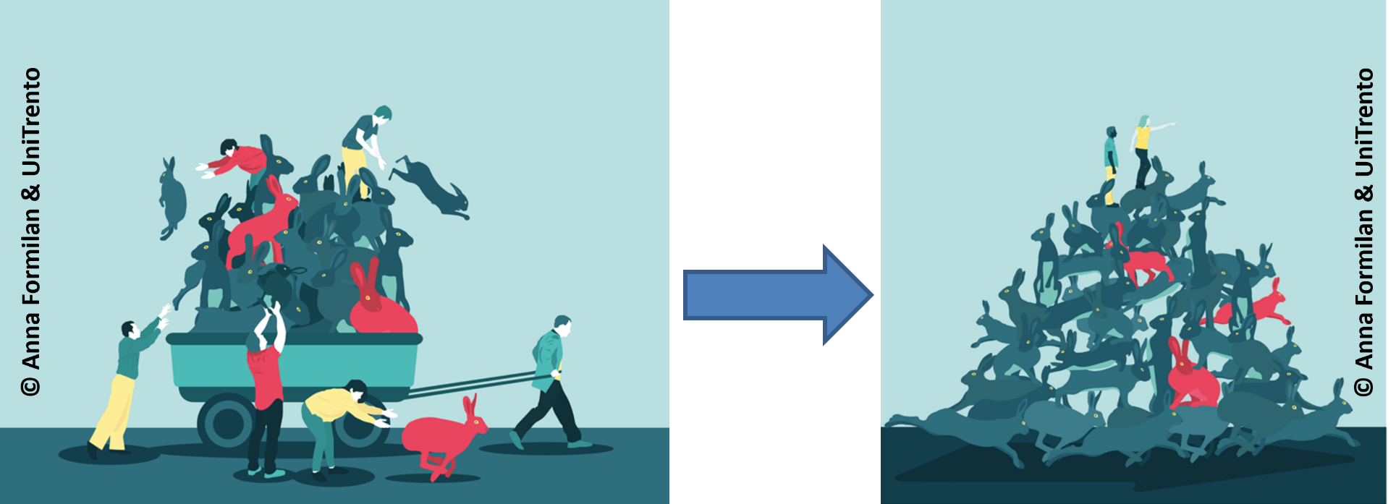
What software really is…
(un)fortunately, it is an aggregation of several components from a variety of supply chains
Work partly supported by the NWO and the European Union

Slide 15
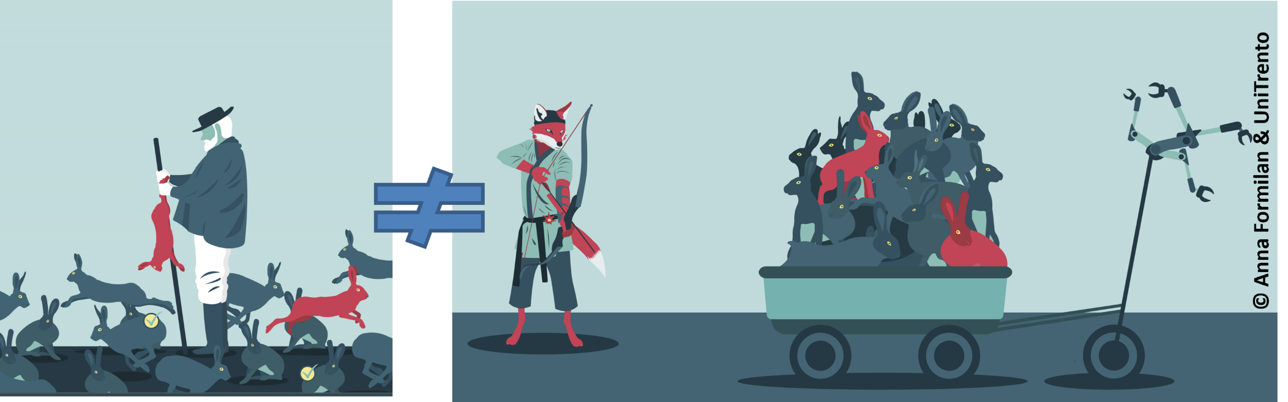
The real game…
So attackers, defenders and regulators play entirely different games
Work partly supported by the NWO and the European Union

Slide 16
Current Attempts to Tame Cyber
GFCE, NIST Cyber Framework...- End-user responsibility
Vulnerability management
Reduce Threats?!
UN norms for cyberspace
Budapest Convention, possible new cybercrime treaty
Ransomware Initiative
“Defend Forward” collaborations

Slide 17
Current Attempts to Tame Cyber
GFCE, NIST Cyber Framework...- End-user responsibility
Vulnerability management
Reduce Threats?!
UN norms for cyberspace
Budapest Convention, possible new cybercrime treaty
Ransomware Initiative
“Defend Forward” collaborations
Stimson Center Accountability Project:
What can be learned from management of other areas of international risk to apply to cyberspace?

Slide 18
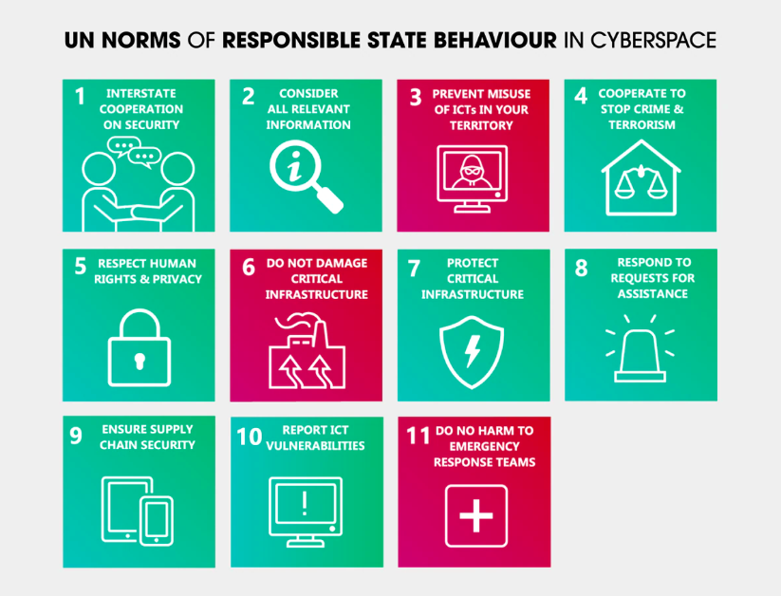
The UN voluntary norms setting out what states should and should not do in the digital space. © Australian Strategic Policy Institute, ASPI https://www.aspi.org.au/cybernorms

Slide 19
Treaties, Laws, Norms, Codes of Conduct, Standards…Prototypes for Cyber?
How get agreement and accountability?
Stimson’s deep dives
Ozone - Montreal Protocol
Weapons of Mass Destruction – UN Security Council 1540
Small arms and light weapons - Arms Trade Treaty
Private military/security contractors – Montreaux+
SAMPLE

Slide 20
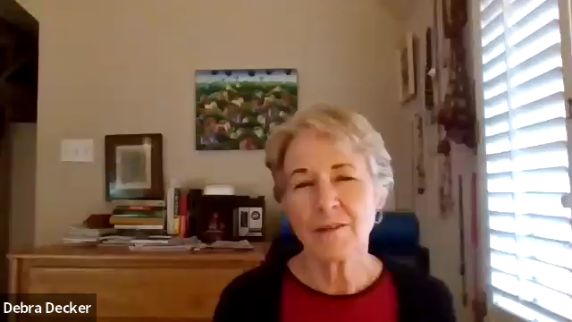
Treaties, Laws, Norms, Codes of Conduct, Standards for Cyber?

Slide 21
Capacity Building & Information Sharing
Web of Trust is the key to information sharing
Regional and International Organizations’ meetings and exercises (e.g., FIRST, APCERT, AfricaCERT, OIC-CERT)
Informal channels may be more effective than formal channels
There is no single or “right” way to build a national CSIRT (mission, authority, constituency, parent organization, national security strategy, funding,…)
International Capacity Building Efforts
APNIC ➔ Tonga, Vanuatu, Samoa CSIRTS
ITU ➔ Provides resources and supported the establishment of 14 CSIRTS
CMU-SEI (CERT/CC) ➔ via US Vision for Cyberspace and Policy, provides trainings and CSIRT establishment/enhancement support
NATO ➔ SPS Trainings, Workshops, Projects, Exercises
EU Cyber Resilience for Development (Cyber4Dev)➔ Over 5000 people trained via 153 training courses and 250 activities (2018-2022)

Slide 22
Maturity Models and Measures
Security Incident Management Maturity Model (SIM3) – Open CSIRT Foundation’s tool – TI Certification
CREST’s Incident Management Framework
National Indexes:
ITU’s Global Cybersecurity Index (22 ind.),
Estonia e-Governance Academy’s National Cybersecurity Index (46 ind.),
Global Cybersecurity Center’s Cybersecurity Capacity Maturity Model

Slide 23
Major Mindset Change Needed
Many still think as Cyber as “One Asset” under “One Control”, “Our nuclear arsenal” vs “Your nuclear arsenal”
UK latest fighter software updates are not controlled by the UK Army → too complex → directly controlled by US private manufacturer
Ancient vs Modern vs Cyber Warfare
Ancient Warfare: each captain was responsible for one’s choice of weapons, paying the salaries of one’s own retinues, allegiance was “flexible” etc.
Modern Warfare: each unit received uniform and equipment based on standard procurements
Might have been poor but was uniform and controlled
Cyber → as ancient mercenary armies with the vengeance of scale...
Results are unsurprising - GAO’s audit 4 Dec 2023
20/23 Federal Agencies failed to meet Biden’s EO at level 3 (all critical covered),
17/23 didn’t move from level 0 (highest criticality not met or partly met)
Work partly supported by the NWO and the European Union

Slide 24
Discussion: How to Progress Cyber Risk Management?
International rules of the road
Agreeing on the risks – definitions, detailed assessments?
Developing possible solutions…
Monitoring
Accountability?
New technologies?
Wicked Problem - Context
World views too different?
Call for new mechanisms: OECD and UN

Slide 25

Discussion Invited!
Thank you!
Debra Decker
Senior Advisor
Stimson Center
Washington, DC
ddecker@stimson.org

Slide 26
Norms for Whom, What?
UNPACKING THE ISSUES
What | Who | Effects on Targets | Controls
Espionage | States | Positions revealed | Accepted?
Surveillance – PI Theft | States, Businesses, Criminals, Individuals | Possible future control, identity theft, financial losses | EU-GDPR; US- HIPPA, CA laws…
Information Campaigns | States, Groups | Influence on policy and populations | In discussion, incl. Human Rights
IP Theft | States, Businesses | Commercial gain | Berne Convention, Patent Law Treaty
Economic disruption (e.g., tech disruptions, ransomware) | States, Criminals, Hacktavists | Harm adversary, financial gain, policy Influence | Ransomware Initiative, Criminal and civil suits
Critical Infrastructure Attack | States, Hacktavists | ……… | International Humanitarian Laws (wartime)
Attack on/by Military | States |  | UN Charter, Laws of War, AI and drones, nuclear command/controls
Note: State can be State, State-supported, State-ignored
Agreed Norms?

Slide 27
Many Overlapping Efforts
Stakeholder Initiatives
Regional efforts, bilateral agreements
Paris Call
Microsoft, Kaspersky
NGOs, Standards…
United Nations
DG Reports….
GGEs and OEWG
Some Efforts to Coordinate and Monitor:
Global Forum for Cyber Expertise
https://thegfce.org/
Geneva Internet Platform's Digital Watch
https://dig.watch/issues

Slide 28
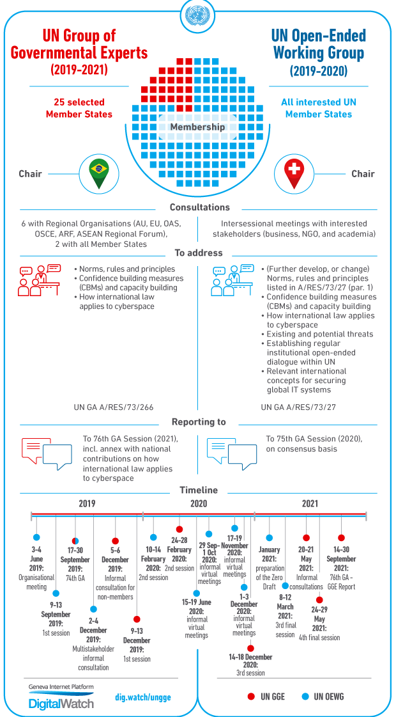
UN First Committee’s Dual Efforts
INTERNATIONAL PEACE AND SECURITY
Both efforts:
Laws & norms
Confidence-building measures
Capacity building
Threats and cooperation
But OEWG:
- Agenda incl. regular institutional dialogue
- Sessions transparent and documented
https://www.un.org/disarmament/open-ended-working-group/
Inter-sessional chaired by Singapore – now chair of new OEWG that goes to 2025
Multi-stakeholder dialogue incl. industry, NGOs and academia with States
OEWG Special

Slide 29
Moving Forward
Who wants a new cyber treaty?!
Building norms based on past
UNIDIR’s Cyber Policy Portal – official policies and statements
GGE’s norms from consensus reports
Existing major agreements: Budapest Convention on Cybercrime, Tallinn Manual 2.0
Moving from Discussion to Action
Program of Action! France, Egypt and dozens of others proposed
Keep multi-stakeholder discussions beyond OEWG
Accept existing norms, id gaps, explore disagreements
See Cyber Policy Statements and Policies from States at: https://unidir.org/cpp/en/
See earlier consensus documents on confidence-building, norm/laws, etc. at: https://www.unidir.org/projects/support-oewg-and-gge-0
See PoA at: https://front.un-arm.org/wp-content/uploads/2020/10/joint-contribution-poa-future-of-cyber-discussions-at-un-10-08-2020.pdf

Slide 30
2015 GGE Report – 11 norms
Limiting Norms
States should not:
* Knowingly allow their territory to be used for internationally wrongful acts using ICTs
* Conduct or knowingly support ICT activity that intentionally damages critical infrastructure
* Conduct or knowingly support activity to harm the information systems of another state’s emergency response teams (CERT/CSIRTS) and should not use their own teams for malicious international activity
States should:
* Take steps to ensure supply chain security, and should seek to prevent the proliferation of malicious ICT and the use of harmful hidden functions
* Respect the UN resolutions that are linked to human rights on the internet and to the right to privacy in the digital age
Good Practices and Positive Duties
States should:
* Cooperate to increase stability and security in the use of ICTs and to prevent harmful practice
* Consider all relevant information in case of ICT incidents
* Consider how best to cooperate to exchange information, to assist each other, and to prosecute terrorist and criminal use of ICTs
*Take appropriate measures to protect their critical infrastructure
* Respond to appropriate requests for assistance by other states whose critical infrastructure is subject to malicious ICT acts
* Encourage responsible reporting of ICT vulnerabilities and should share remedies to these
From: https://ccdcoe.org/incyder-articles/2015-un-gge-report-major-players-recommending-norms-of-behaviour-highlighting-aspects-of-international-law/. See report at:

Slide 31
Stimson’s Cyber Program, including Recorded Events: https://www.stimson.org/program/cyber/
Image Credits:
Slide 25, blogtrepreneur.com/tech
Slide 29, Geneva Internet Platform: https://dig.watch/processes/un-gge

