Slide 1
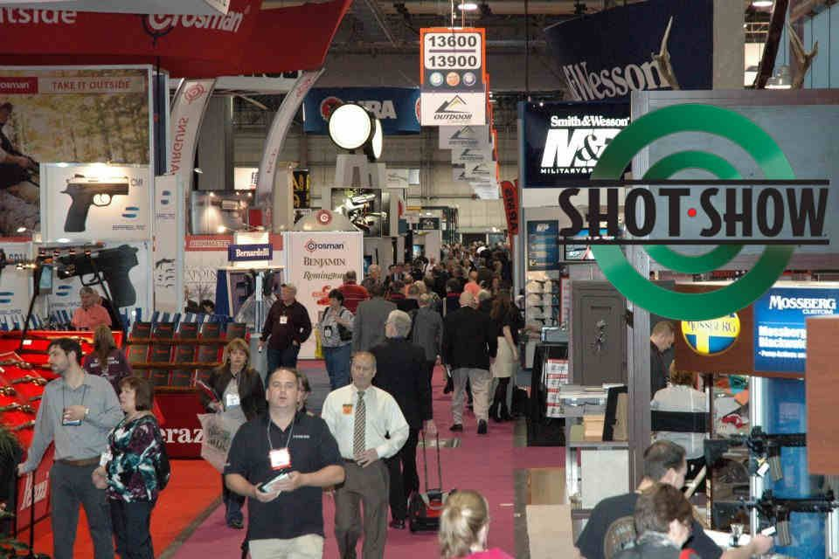
THE ROLE OF THE U.S. GUN MARKET IN SMALL ARMS TRAFFICKING TO MEXICO AND CENTRAL AMERICA
May 2020

Slide 4
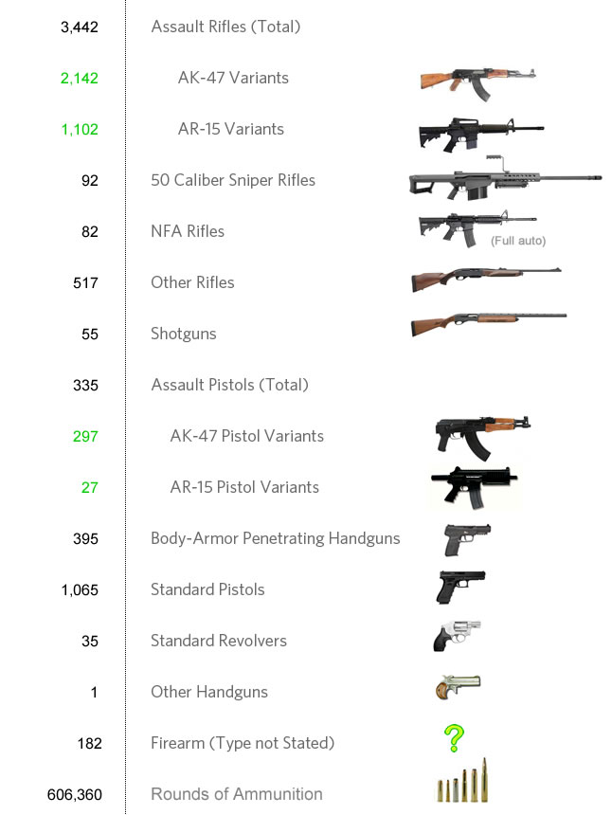
VPC ANALYSIS OF 183 FEDERAL CROSS-BORDER GUN TRAFFICKING PROSECUTIONS

Slide 5
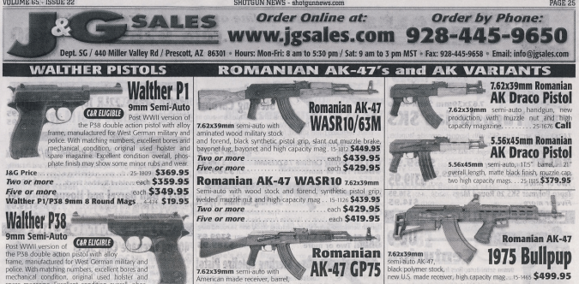
ANYONE WHO CAN PASS A BACKGROUND CHECK CAN BUILD THEIR OWN ARMY WITH FIREARMS AND ACCESSORIES READILY AVAILABLE AT U.S. GUN STORES

Slide 6
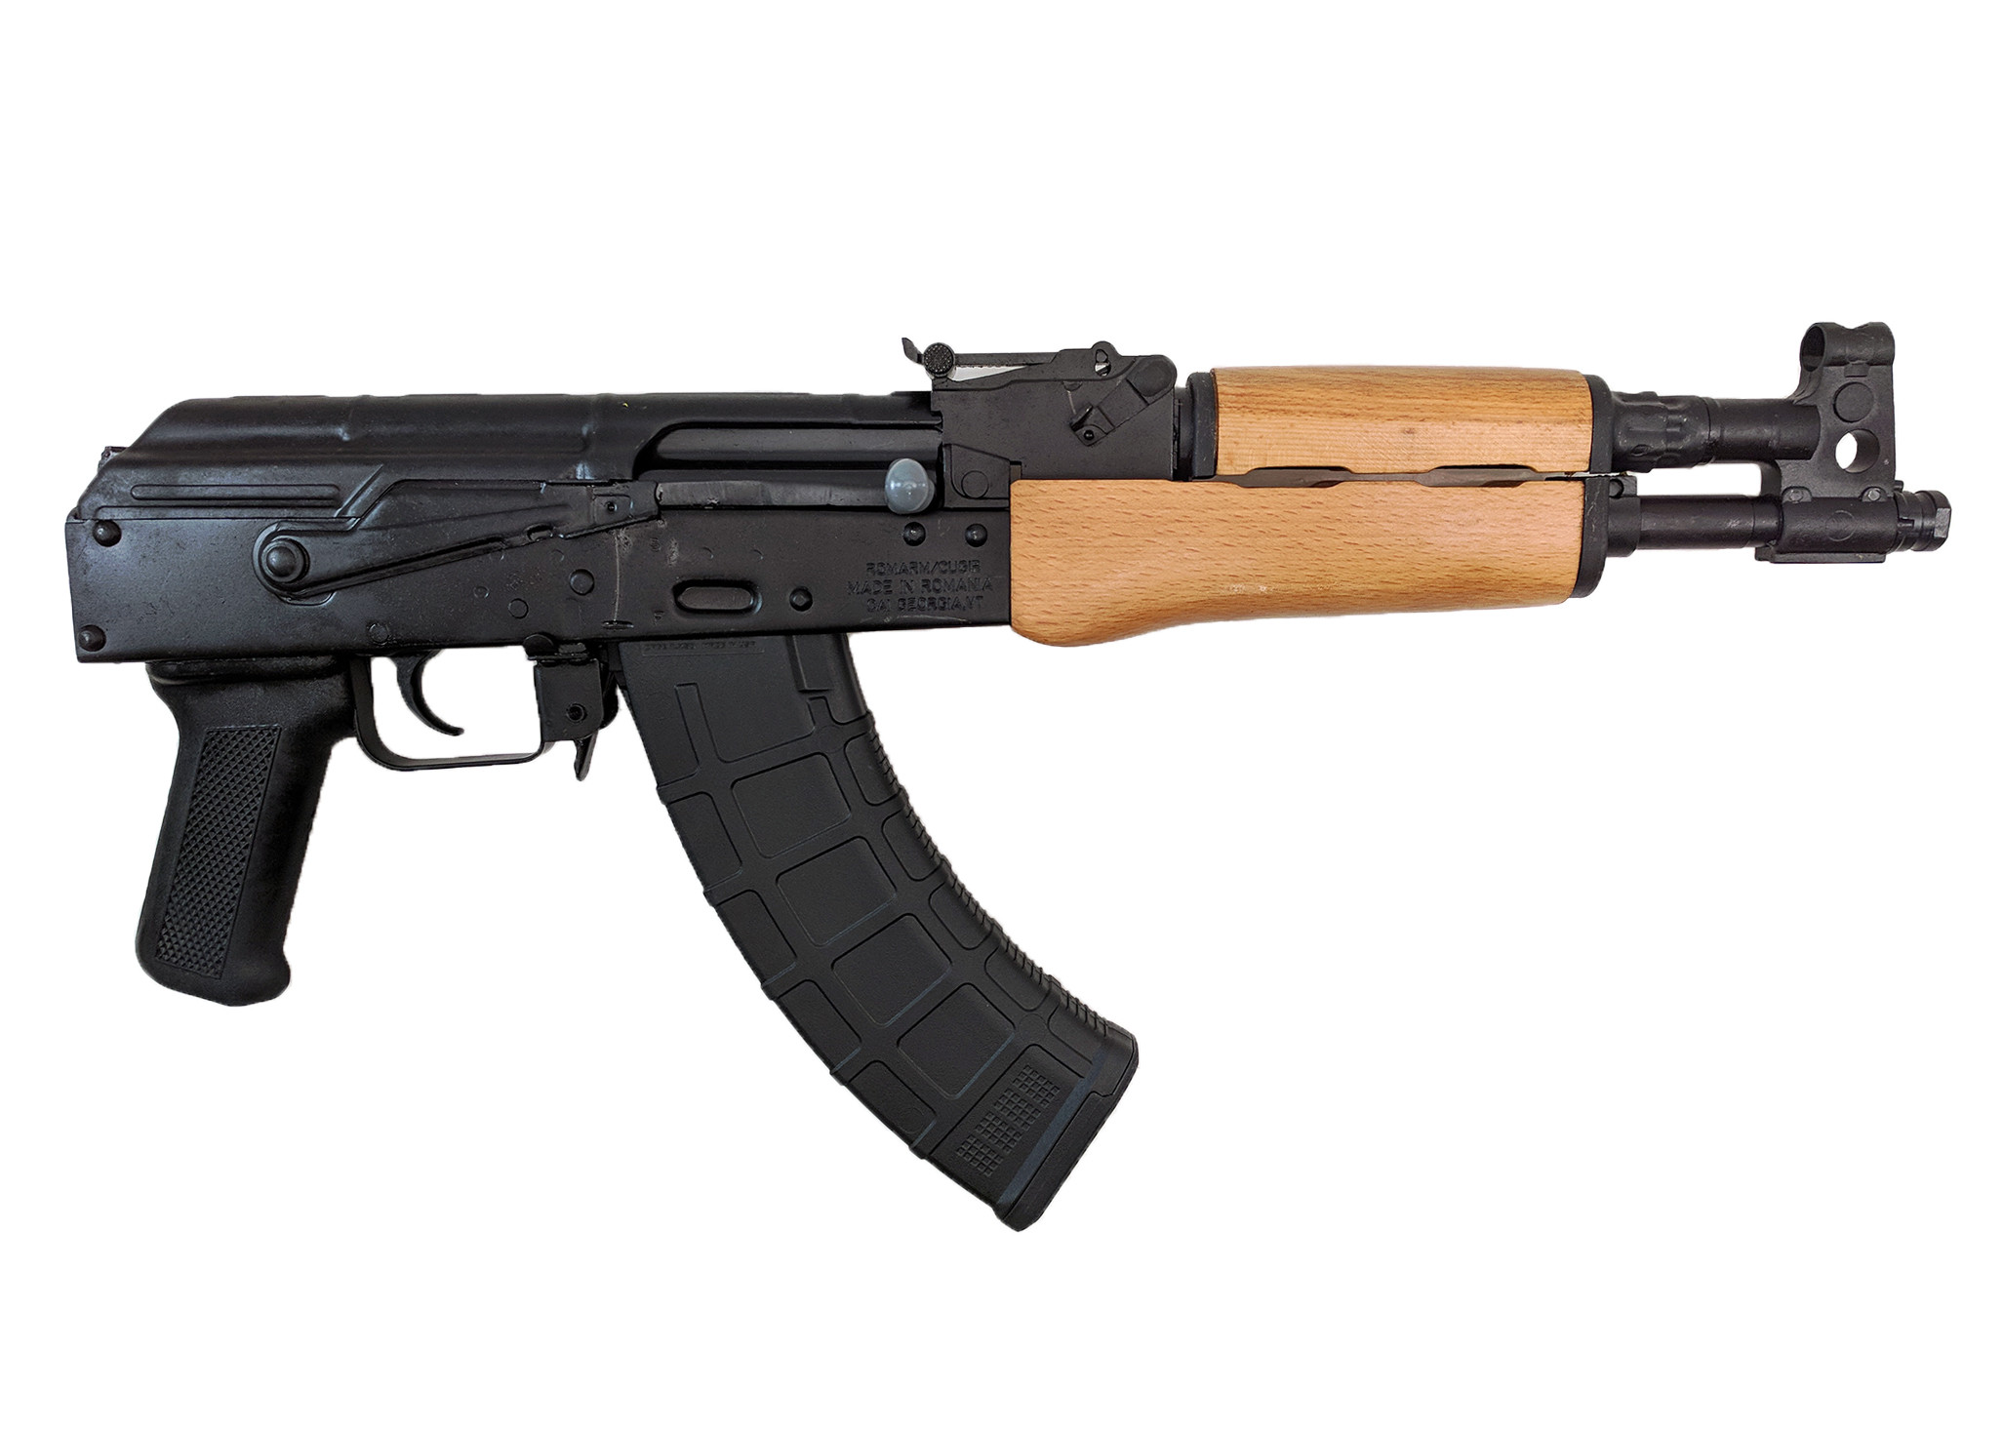
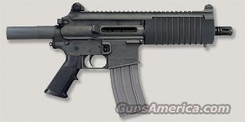
TYPES OF WEAPONS PREFERRED BY TRAFFICKERS—AK-TYPE AND AR-TYPE RIFLES AND PISTOLS

Slide 7
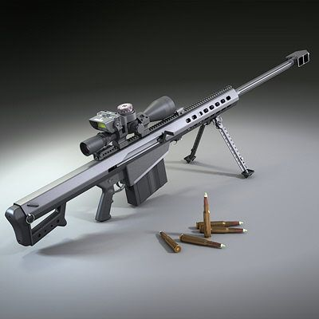
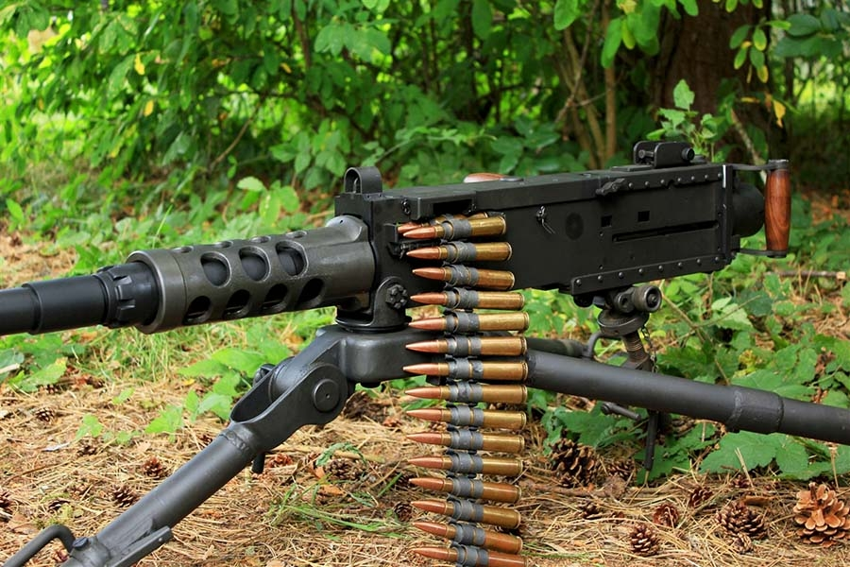
TYPES OF WEAPONS PREFERRED BY TRAFFICKERS—50 CALIBER RIFLES

Slide 8
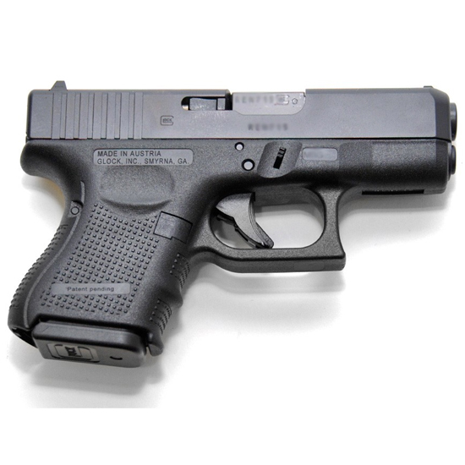
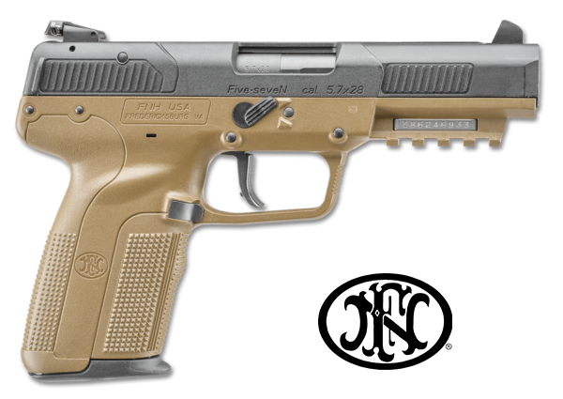
TYPES OF WEAPONS PREFERRED BY TRAFFICKERS—”ARMOR-PIERCING” AND OTHER SEMIAUTOMATIC PISTOLS

Slide 9
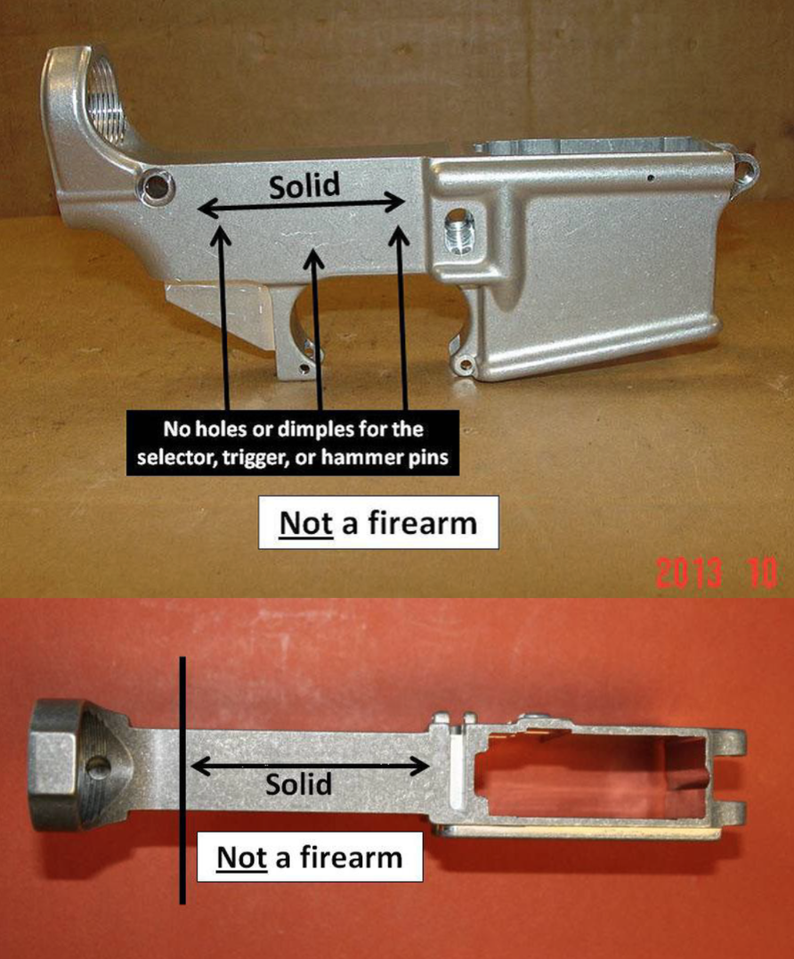
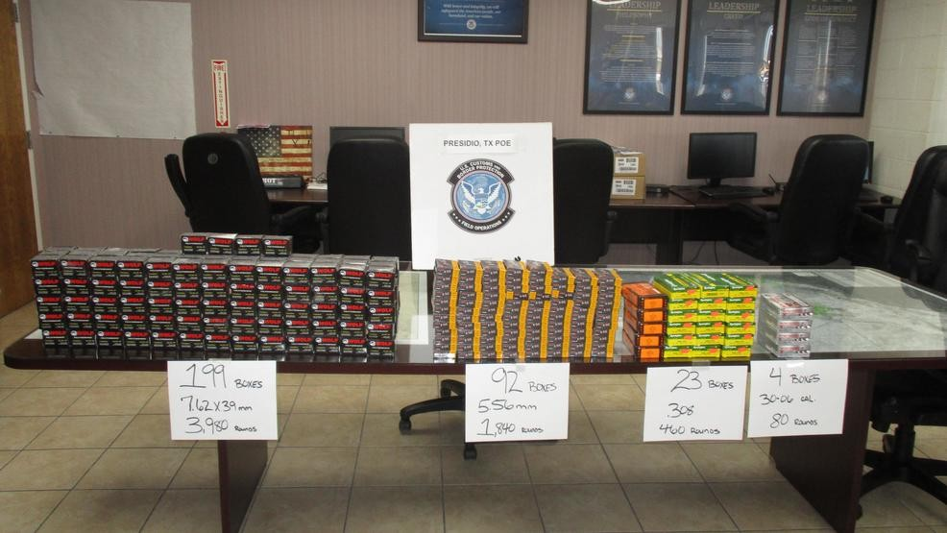
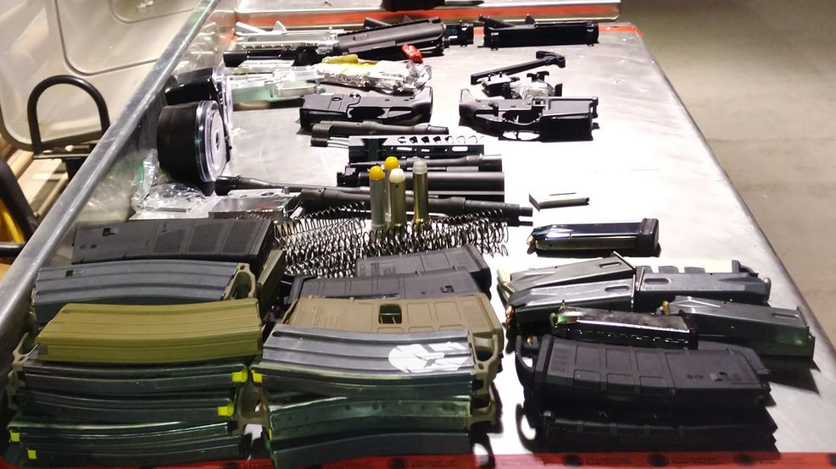
TRENDS IN TYPES OF WEAPONS PREFERRED BY TRAFFICKERS—”80 PERCENT” RECEIVERS, LARGE QUANITITIES OF AMMUNITION, AND LARGE-CAPACITY MAGAZINES

Slide 10
THE MAJORITY OF THE 183 TRAFFICKING CASES ANALYZED INVOLVED STRAW BUYERS ACQUIRING GUNS FROM LICENSED DEALERS

